Slide 1
Fundamentals and Methods of Computer Science
Exercise week 3

Slide 2
Today’s Menu
Discussion of assignment 2 and the respective quiz
Brief summary of skills necessary to solve assignment 3
Working on assignment 3

Slide 3
Discussion of assignment 2 and the respective quiz

Slide 4
Assignment 2 & Quiz 2: What the questions were about
print vs. assignment / print vs. return
range()
for-loop
typecasting
# Assignment:
# you don’t see anything, the computer does
a = "assigned"
# Print:
# you see something, the computer doesn’t
print("printing")
# In a function:
def my_func():
print("printed")
return "returned"
b = my_func()
print(‘Hello World’)
Hello World
print(‘Hello’, ‘World’)
Hello World
x = 5
y = 6
print(x + y)
11
print(‘The result of x + y is’, x + y)
→ The result of x + y is 11

Slide 5
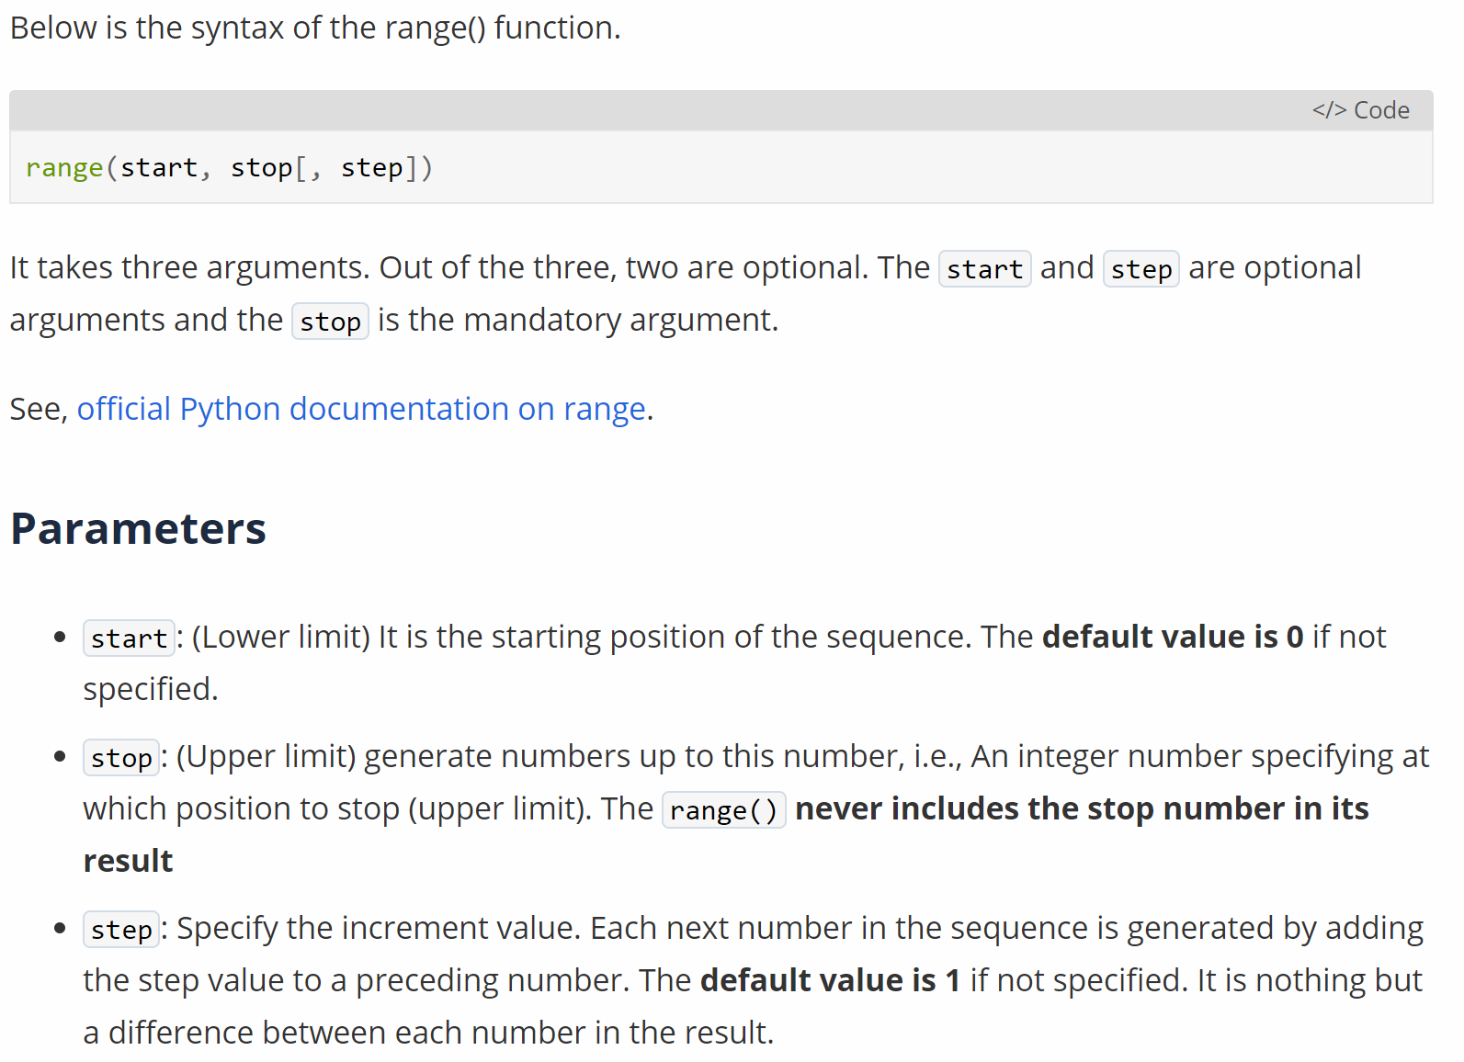
Assignment 2 & Quiz 2: What the questions were about
print(range(10), type(range(10)))
print(list(range(10)), type(list(range(10))))
range(stop) # (0, x, 1)
range(start, stop) # (x, y, 1)
range(start, stop, step) # (x, y, z)
print vs. assignment / print vs. return
range()
for-loop
typecasting
range() creates an iterable → think about it like a list of numbers (but it’s not really list type)
print(‘Hello World’)
Hello World
print(‘Hello’, ‘World’)
Hello World
x = 5
y = 6
print(x + y)
11
print(‘The result of x + y is’, x + y)
→ The result of x + y is 11

Slide 6

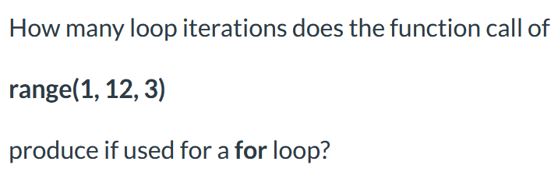
Assignment 2 & Quiz 2: What the questions were about
print vs. assignment / print vs. return
range()
for-loop
typecasting
# everything in for-loop is overwritten in
# each iteration → define variable before
sum_numbers = 0
# in each iteration the next value from the
# iterable is assigned to the variable:
# #1 variable = 0, #2 variable = 1, ...
for variable in range(10):
# then the indented code is executed
# for each iteration
sum_numbers += variable
# Optional, if we want to see it
print(sum_numbers)
print(‘Hello World’)
Hello World
print(‘Hello’, ‘World’)
Hello World
x = 5
y = 6
print(x + y)
11
print(‘The result of x + y is’, x + y)
→ The result of x + y is 11

Slide 7
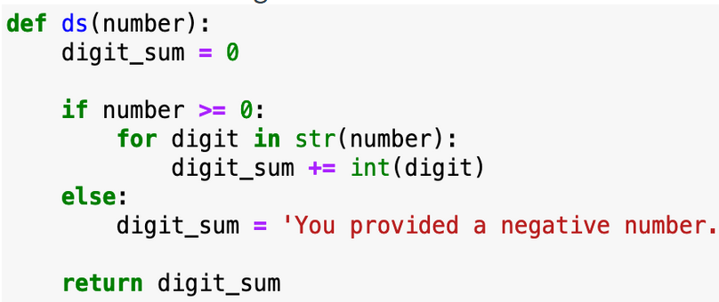
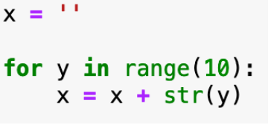
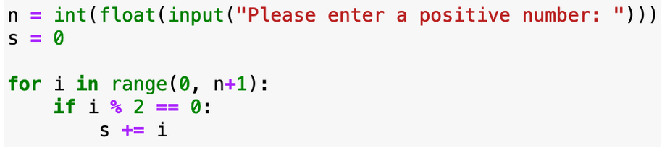
Assignment 2 & Quiz 2: What the questions were about
print vs. assignment / print vs. return
range()
for-loop
typecasting
# range creates an iterator of INTEGERS
sum_numbers = 0
for variable in range(10):
sum_numbers += variable
# if we want to treat it as STRINGS
seq_numbers = ""
for variable in range(10):
seq_numbers += str(variable)
# complicated example
a = ""
for num in range(100, 300, 17):
b = 0
for char in str(num):
b += int(char)
a += str(b)
print(‘Hello World’)
Hello World
print(‘Hello’, ‘World’)
Hello World
x = 5
y = 6
print(x + y)
11
print(‘The result of x + y is’, x + y)
→ The result of x + y is 11

Slide 8
Brief summary of skills necessary to solve assignment 3

Slide 9
Introduction to Python:
1.6
2.5
To read up

Slide 10
Functions
A function is a block of code that only runs when it is called by its function name
You can pass data, known as parameters, into a function.
A function can return data as a result.
Instead of using already defined functions (Python / library), we can define our own:
def my_function(number):
x = 5
y = 3
z = x + y + number
return z
print(my_function(2)) # this is the function call
Know how to define and use:
Default parameters
Keyword arguments
Argument lists

Slide 11
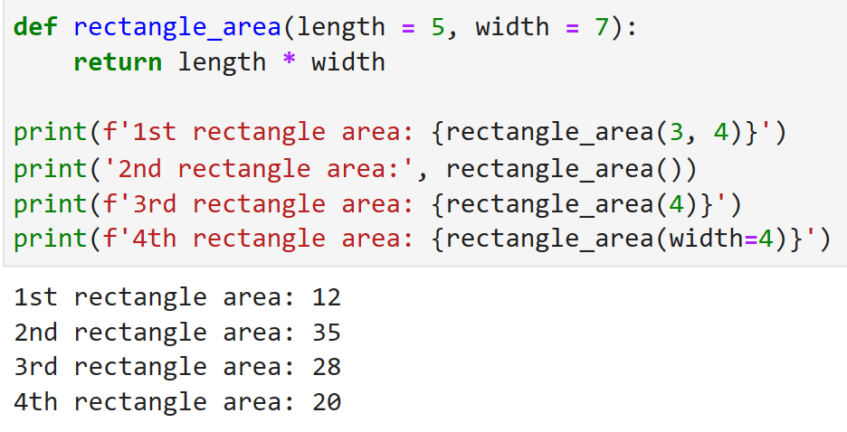
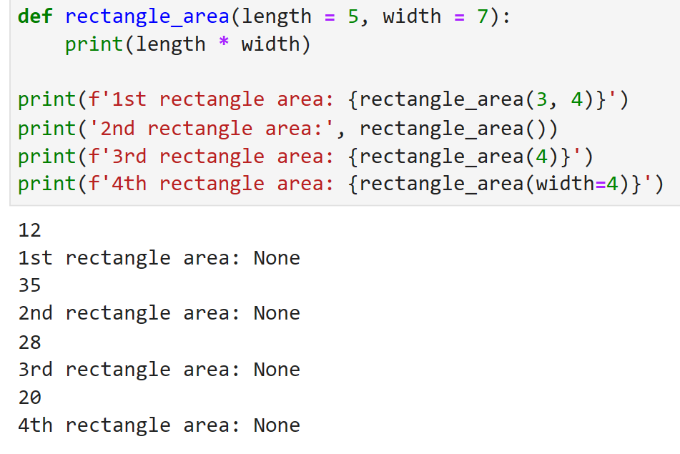
Functions and Default parameter values
Can you identify a function? a parameter? an argument?
Be aware! A print() is not a return!

Slide 12
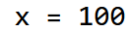
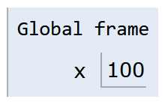
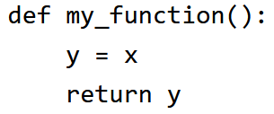
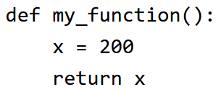
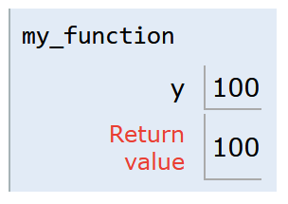
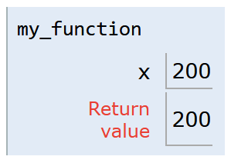
Scope / Namespace
Note: Not everything that is indented (e.g. if/else or loops) creates its own local scope.
For now it is sufficient to understand that each function creates its own local scope which is destroyed after executing the function.
This is the global scope.
Variables defined here can be accessed from everywhere.
Variables defined in a lower scope (local) can not be accessed from here.
This is the local scope.
Variables defined here can only be accessed from within.
Variables defined in a higher scope (global) can also be accessed (but not changed [except global statement is used]) from here.
12

Slide 13
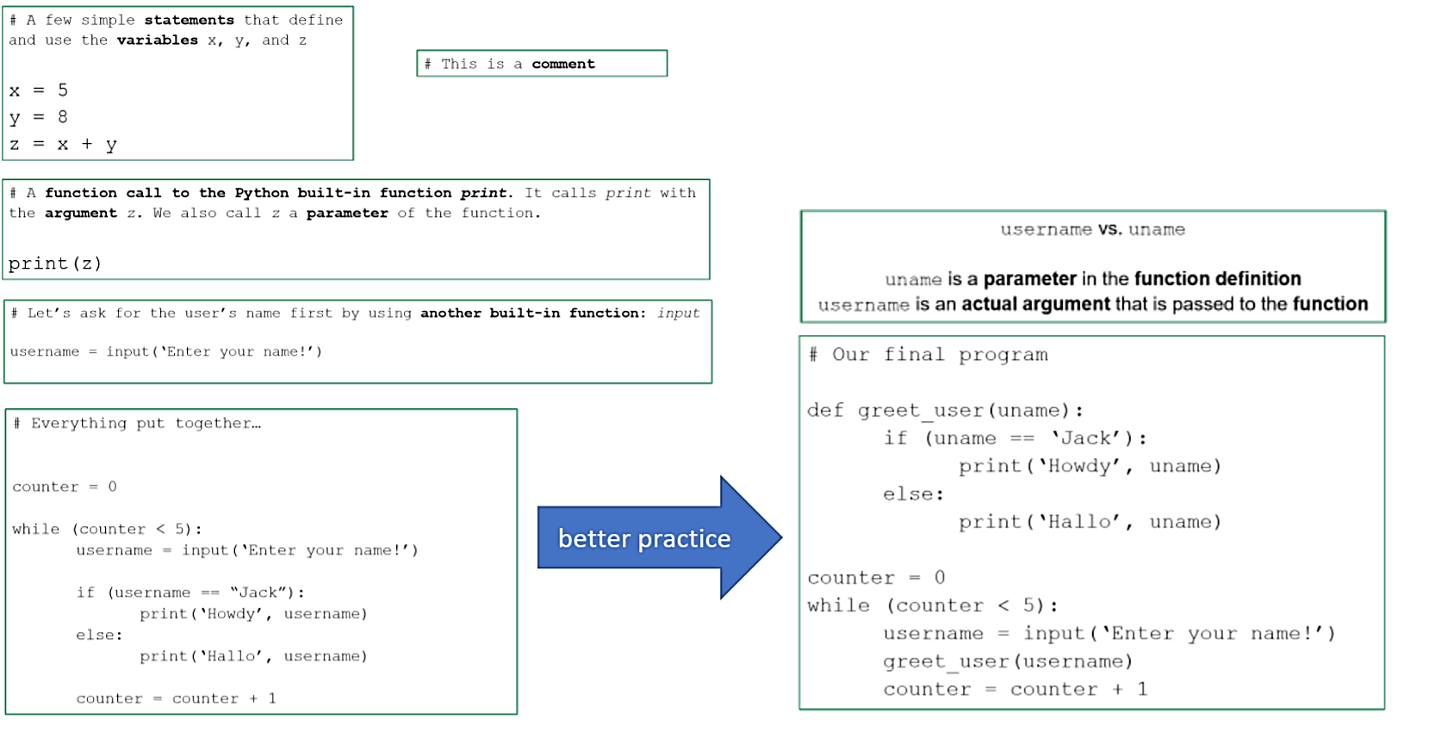
Self-check in 1 slide

Slide 14
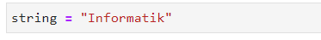
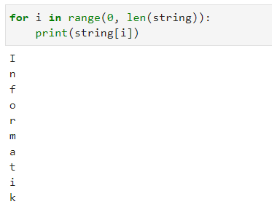
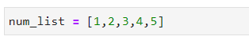
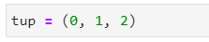
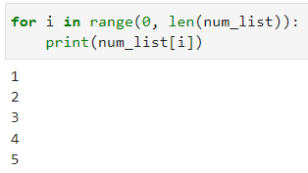
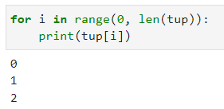
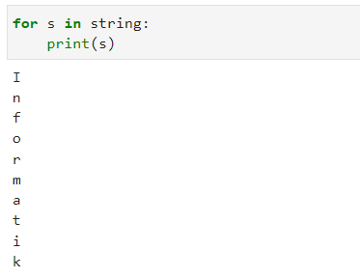
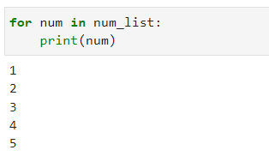
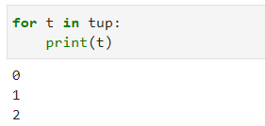
Strings, Lists and Tuples – Similarities
Lists, Strings and Tuples are iterables! This means we can access each
element one by one by using an iteration (i.e. a loop, like for or while)

Slide 15
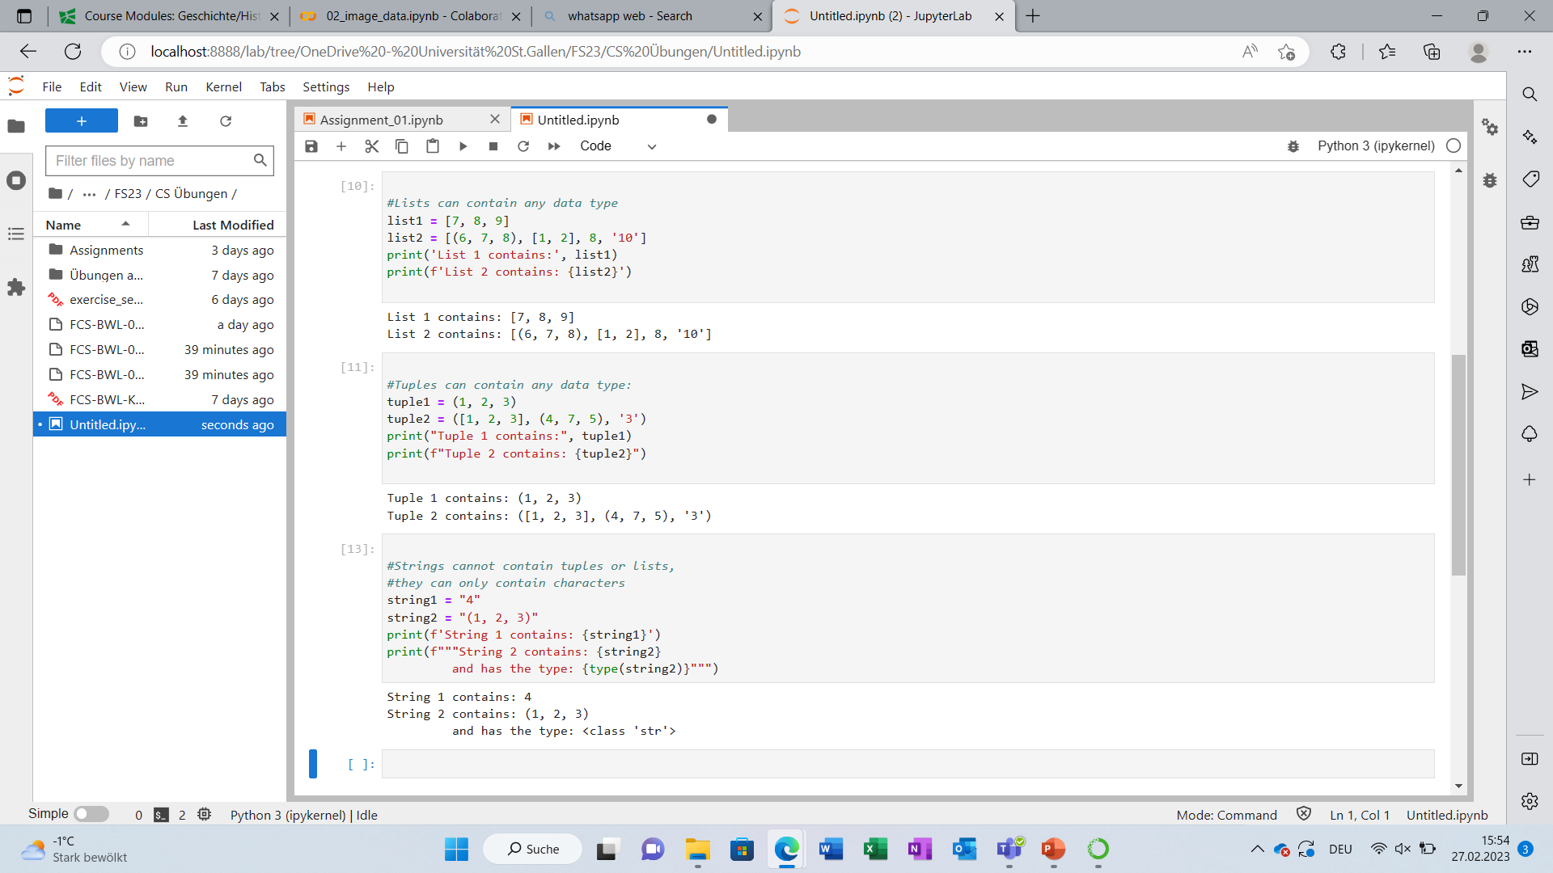
Strings, Lists and Tuples – Differences (1)
We can save any data types in lists and tuples, even other lists and tuples. But string only supports characters, int, or float and the last two must be turned into strings first (i.e. inside of quotes)!

Slide 16
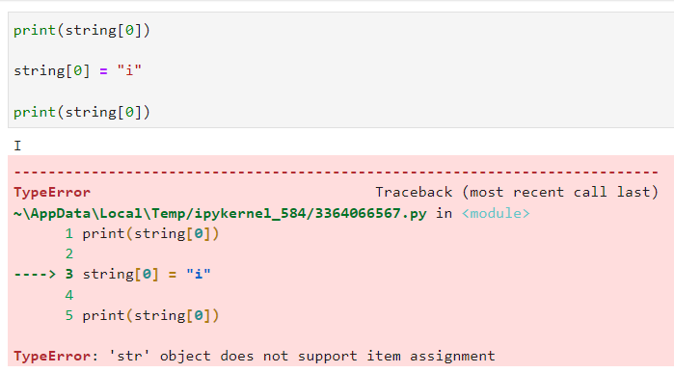
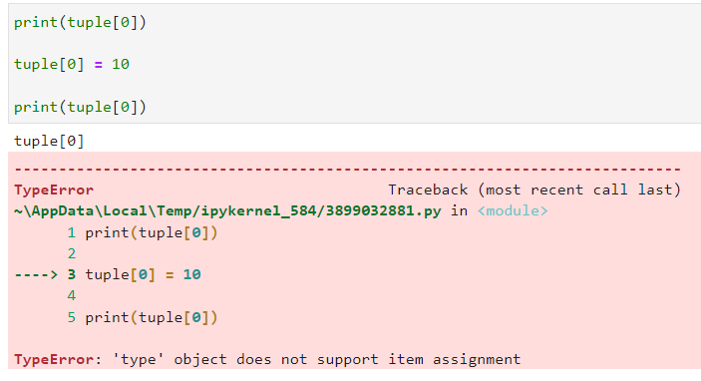
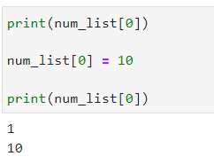
Strings, Lists and Tuples – Differences (2)
Lists are mutable, meaning we can change the values of elements by accessing them one at a time. Tuples and strings on the other side are immutable, meaning we cannot alter them.

Slide 17
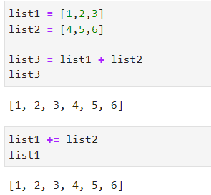
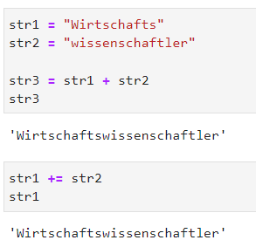
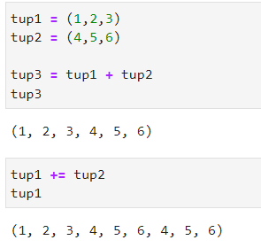
Concatenating Lists, Strings and Tuples
We can concatenate Strings, Lists and Tuples using "+" or "+="
→ For immutables (strings, tuples) think of "+=" as «overwriting»

Slide 18
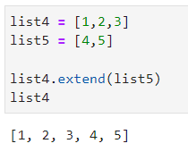
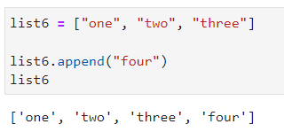
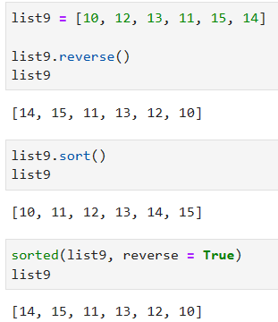
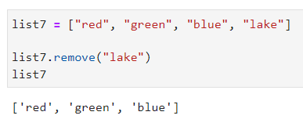
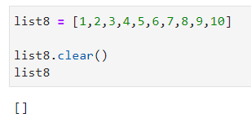
Built-in functions to manipulate Lists
Be aware! They can only be used with Lists since they are mutable!
Have a look at their documentation: Data Structures – Documentation sort() VS sorted()
extend()
append()
reverse(), sort(), sorted()
remove()
clear()

Slide 19
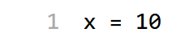
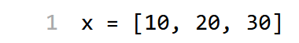
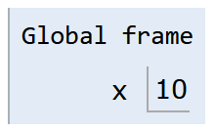
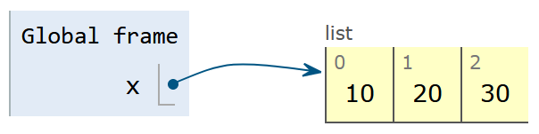
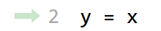
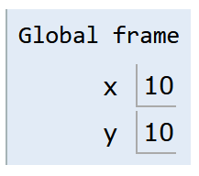

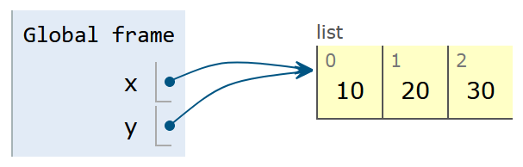
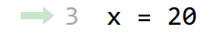
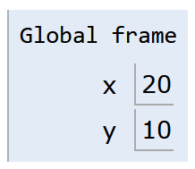
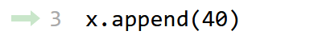
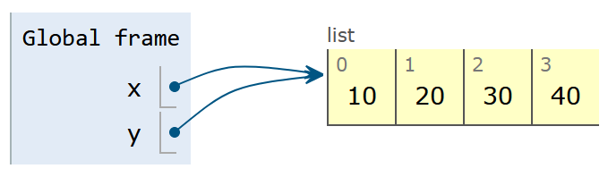
Pass by …
Value
Reference
Reference
All single values (numbers, text, boolean) follow this behaviour.
Collections usually follow this behaviour. Most important here are lists.
19

Slide 20
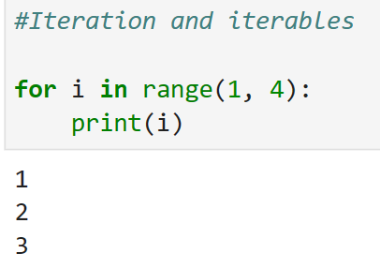
Vocabulary to keep in mind
Variable = value that is stored in the computer’s memory
Function = block of organized, reusable that performs a specific task
Parameter = variable that is defined as part of the function definition
Argument = value that is passed to a function when it is called
Keyword Argument = value that is passed a function with a name that matches the parameter name in the function definition
Iteration = "Repetition" in a loop
Iterable = "container" that can store any variable and returns it one by one

Slide 21
Exercise 3:
Let’s solve the exercise together…
…to enable you to solve the assignment on your own!

Slide 22
Short “summary” of Coding Python in 7 Slides
Let’s take a look at the slides from last week and what is still open.

Slide 23

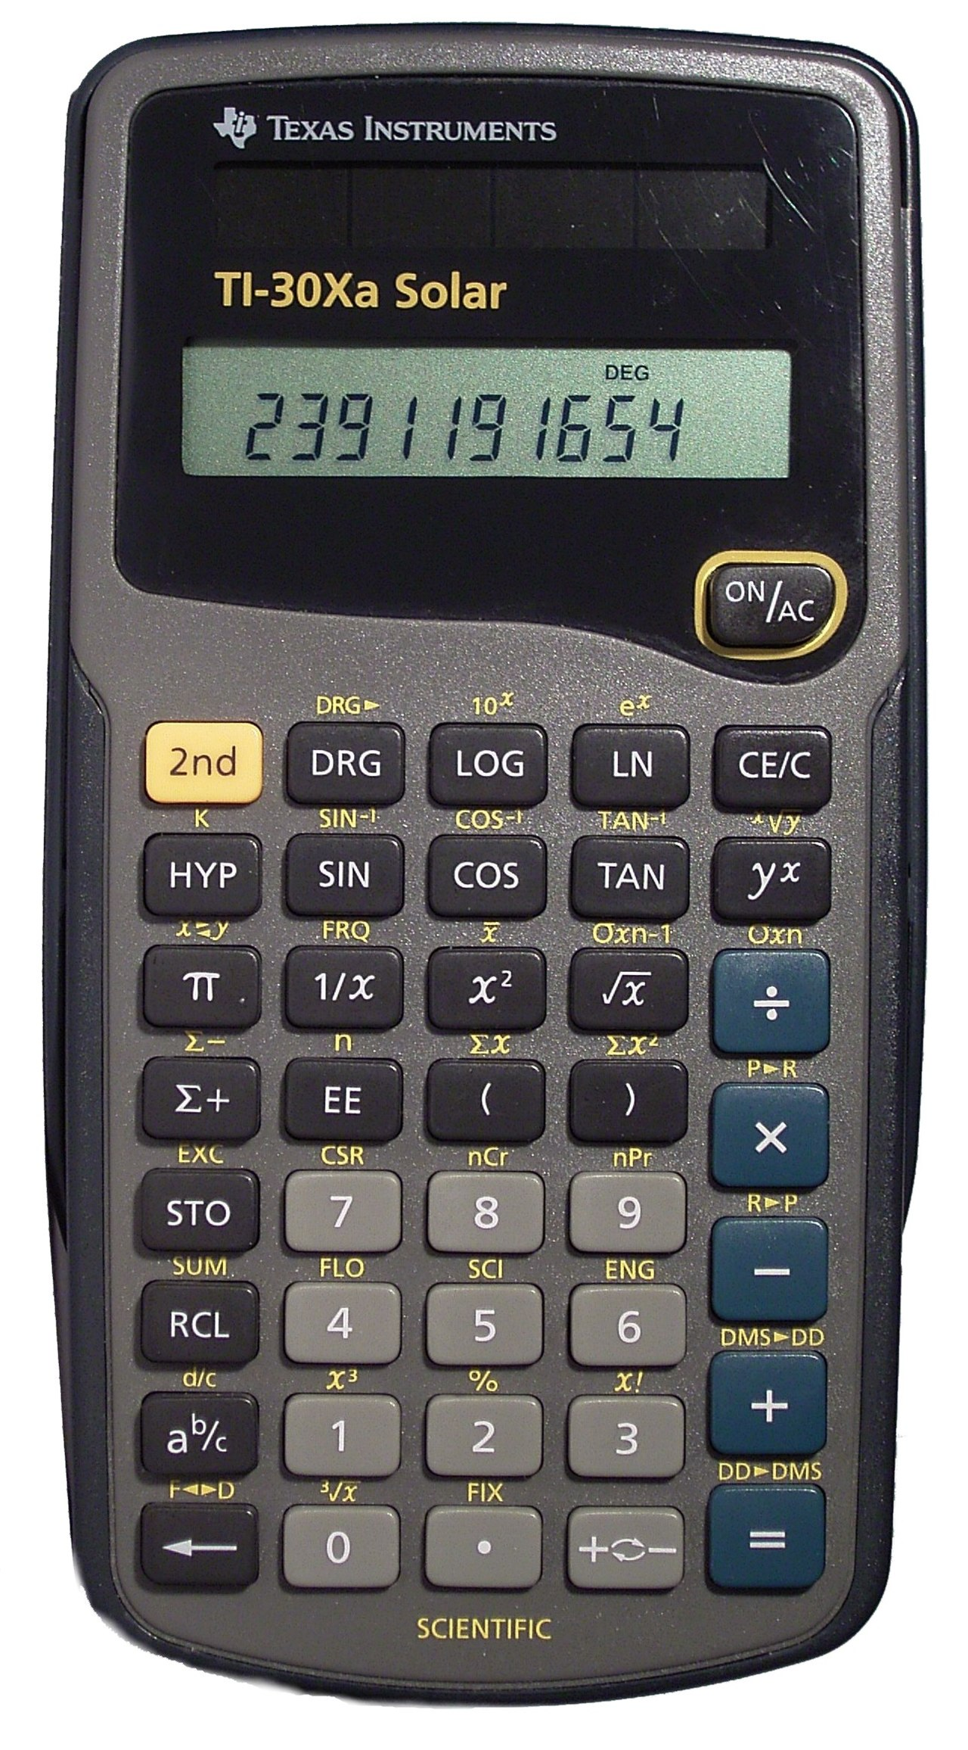
Introduction
A Simple Calculator as your first computer program!
You will learn how to assign values to variables and to do basic calculations
There are among others the following arithmetic operations in Python:
Addition: +
Subtraction: -
Multiplication: *
Division: /
Power Function: **
Example: 3**2 = 9 same as 3^2 (often written like that in Excel)
Modulo Function: %
In computing, the modulo operation returns the remainder of a division, after one number is divided by another (called the modulus of the operation)
Example: 17 % 5 = 2 (15/5 = 3 → the remainder up to 17 is 2)
So, Modulo does integer divisions and returns the remainder

Slide 24
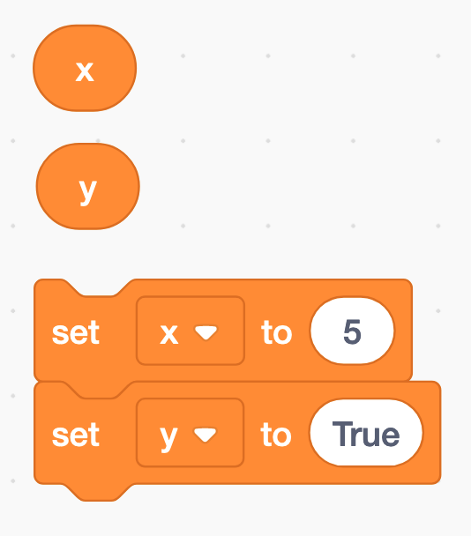
Assigning a value to a variable
The equal sign (=) is used to assign values to variables
x = 5
y = True
etc.

Slide 25
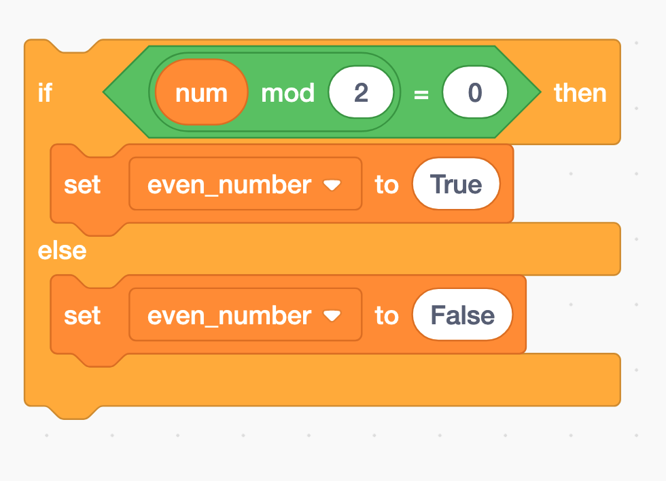
Modulo and if-statements (1)
if num % 2 == 0:
even_number = True
else:
even_number = False

Slide 26


Modulo and if-statements (2)
num = 4
if num % 2 == 0:
even_number = True
else:
even_number = False
print(even_number)

Slide 27


Modulo and if-statements (3)
num = 5
if num % 2 == 0:
even_number = True
else:
even_number = False
print(even_number)

Slide 28


Functions
A function is a block of code that only runs when it is called by its function name
You can pass data, known as parameters, into a function.
A function can return data as a result.
def my_function(number):
x = 5
y = 3
z = x + y + number
return z
print(my_function(2)) # this is the function call

Slide 29
Python data types → next week
Python has five standard data types:
Numbers
Sequences (Strings, Lists, Tuples)
Dictionaries
Sets
Boolean
Python sets the variable type based on the value that is assigned to it. Unlike more other languages, python will change the variable type if the variable value is set to another value. For example:
var = 123 # this will create a variable with type integer
var = ‘john’ # the “var” variable has now as type string
type(var) # returns the data type of the “var” variable
var_2 = ‘5’
var_2 = int(var_2) # changes the string variable var_2 to an integer variable (if possible)
int | a = 10 | Integer (whole number)
float | a = 45.67 | (.) Floating point real values
Numbers

Slide 30
Now you have everything you need to start with assignment 3

Slide 31
<Your Name>
<Function>
lirst.last@<student.>unisg.ch

